Slide 1
Week-4 Team Presentation
Team Name: Gladiators
Team Members: Shivani Asokuma, Akash Narang, Mit Jain, Juhi Malkani
Team Lead: Mit Jain

Slide 2
Project: E-commerce Website
Description: A website where users can buy/sell products
Features
Shopping Cart/ WishList
Home page, Featured Products page, individual product page
Authentication for buyers and sellers
Filtering based on products
Payment module
User management
Seller module
Product to be sold: Footwear

Slide 3
Technologies Used
MERN Stack (MongoDB, Express, React, NodeJS)
Frontend: React
Backend: Express, NodeJS
DB Management: MongoDB

Slide 4
Milestones for current week
Finalize implementation of template
Separate components for different parts of UI
Plan how to pass data between components
Start making API endpoint list
API and CRUD operations for Product Listing page
Host the backend server on AWS
Implement Add to Cart functionality, individual Product Page

Slide 5
What’s been accomplished so far
Integrated bootstrap template in React
Started separating components needed for UI
Added routing between the pages using ‘react-router-dom’
Setting up the folder structure for frontend development
Designed the high level structure of MongoDB collections
Hosted the backend server on AWS using an EC2 instance.
Built an CRUD API to test end-to-end connection between hosted backend and remote nodejs application

Slide 6
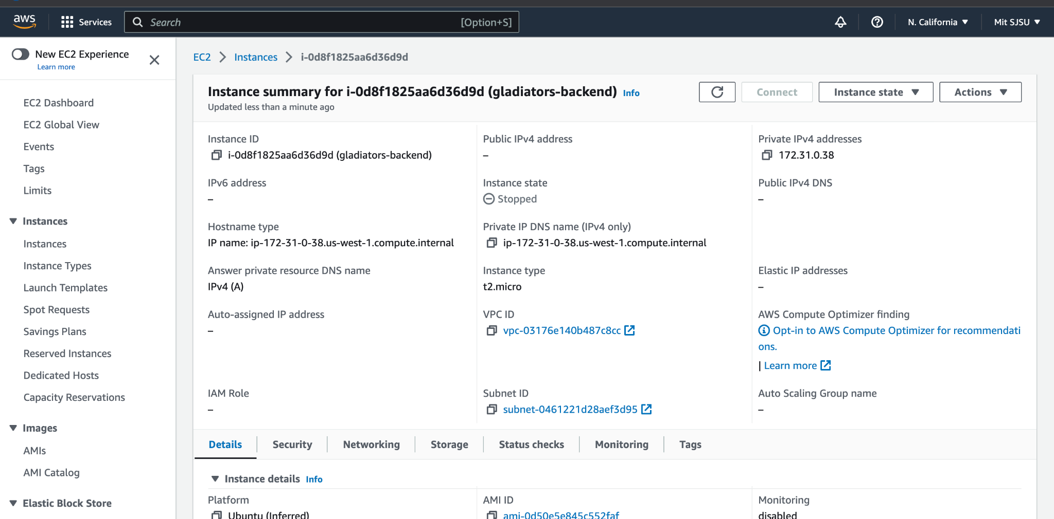

Slide 7
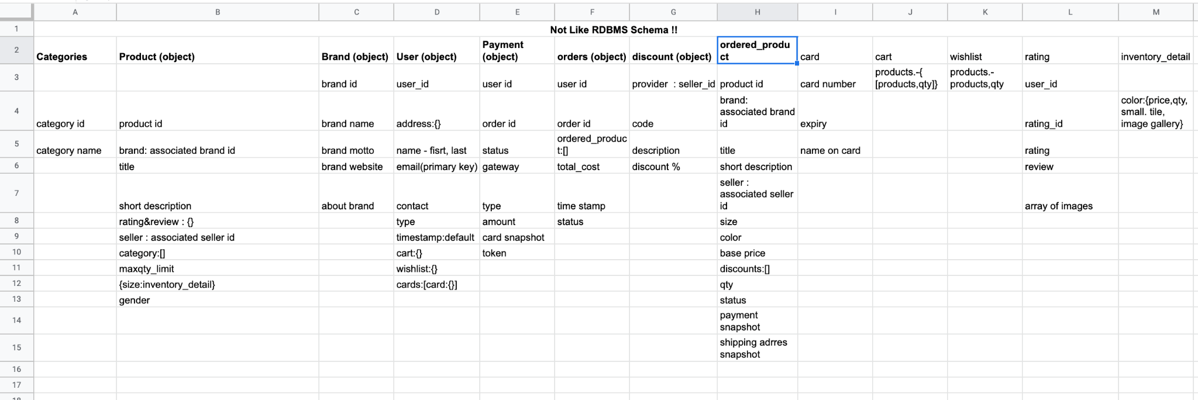

Slide 8
What’s in progress (On track to complete by the end of week)
Implementing required MongoDB collections programmatically in the form of data models in node.js for Product Listing API
CRUD API for product listing page
Creating an API endpoint list

Slide 9
Role Assignments
Shivani: Frontend
Mit: Mostly working on Backend but also helping with Frontend
Akash: Backend
Juhi: Frontend

Slide 10
Job Assignments for Week-5
Akash - Understanding integration of MongoDB with Node.js, Finish making an API end-point list (not exhaustive), Implement APIs for Home Page, enhance API to accommodate advanced features like product filtering
Juhi - Continue learning React.js, integrate bootstrap templates and start adding functionalities to them
Shivani - Start separating components and add functionalities (Add to Cart)
Mit - Finish making an API end-point list (not exhaustive), Implement APIs for Home Page, enhance API to accommodate advanced features like product filtering

Slide 11
Blockers
Integrating the bootstrap template into React was more complicated than expected.
We had to divide it up into pages and change parts that were throwing errors
Members are still getting acquainted with the tech stack because we wanted to challenge ourselves and work on a new tech stack without prior experience, due to this, it is taking us some time to ramp up the coding.

Slide 12
Response to Feedback
Feedback: Filters may be a problem if product selection isn’t large enough
We plan to set up our own APIs with the product data
If needed, we will be able to add more data to the API so that we have a bigger collection of products
Feedback: Connect to Paypal / Google API
(Tentative) We’re planning on using Paypal’s developer API for the payment feature

Slide 13
Thank you!

